Slide 1
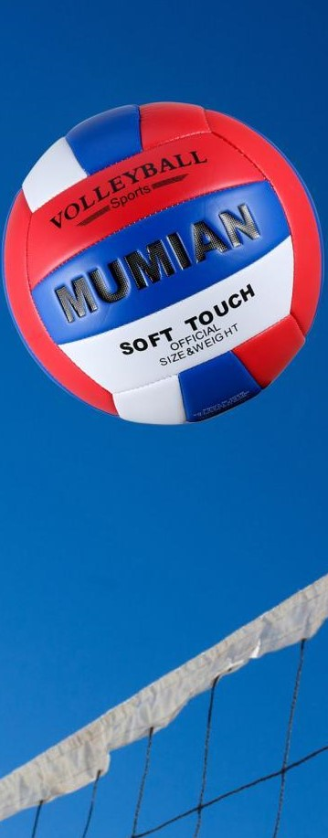
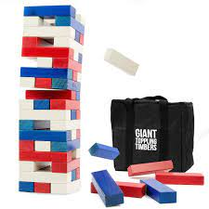
Westside High School
Nov. 28- Dec.2 Week At a Glance (WAG)

Slide 2
Coach Thomas
Rec. Games: Nov.28-Dec.2

Slide 3
Nov. 28
Standard:
PERG.1 The physically educated student demonstrates competency in a variety of motor skills and movement patterns.
a. Demonstrates competence while performing skills in a variety of recreational game settings and activities
b. Performs skills at a level of competence, which contributes to health-related fitness.
c. Demonstrates proper warm-up and cool-down protocol associated with different life time
sport physical activities.
PERG. 2 The physically educated student applies the knowledge of concepts, principles, strategies, and tactics related to movement and performance.
Integrates a variety of strategies, tactics, concepts, and skills during recreational games activities
Evaluates skills needed for recreational games and leisure activities
PERG.3 The physically educated student demonstrates knowledge and skills to help achieve
and maintain a health-enhancing level of physical activity and fitness.
a. Maintains or improves fitness level by using the results of the Georgia Fitness Assessment
to guide changes in a personal program of physical activity.
b. Uses technologies to assess, enhance, and maintain health-related and skill-related fitness.
c. Analyzes the relationship between physical activity and longevity.
Personal and Social Behavior, Rules, Safety, and Etiquette
Monday - Agenda
Learning Target
I can explain how to play corn hole
I can use various skills and strategies to compete against peers while working with teammates
Opening ( 10-15 mins)
5-10 minute Walk & Attendance
Work-session ( 20 - 25 mins)
Locker rooms (5 minutes)
Coach will explain how corn hole is played including introducing the equipment necessary to play
Student will partner up with a peer and compete in a game of cornhole
Teacher will create brackets for tournament of cornhole to “crown” the winners of the tournament
Criteria for Success
Students can explain the point system for the game corn hole
Students can describe how the game of corn hole is played and won
Students can play a game of corn hole with peers and use own knowledge and skills to determine winners
Students can use various strategies to play corn hole
Closing ( 05 – 10 mins)
-locker room unlocked for 5 minutes
-students use remaining time to cool down & rehydrate if necessary

Slide 4
Nov. 29 Standard:
PERG.1 The physically educated student demonstrates competency in a variety of motor skills and movement patterns.
a. Demonstrates competence while performing skills in a variety of recreational game settings and activities
b. Performs skills at a level of competence, which contributes to health-related fitness.
c. Demonstrates proper warm-up and cool-down protocol associated with different life time
sport physical activities.
PERG. 2 The physically educated student applies the knowledge of concepts, principles, strategies, and tactics related to movement and performance.
Integrates a variety of strategies, tactics, concepts, and skills during recreational games activities
Evaluates skills needed for recreational games and leisure activities
PERG.3 The physically educated student demonstrates knowledge and skills to help achieve
and maintain a health-enhancing level of physical activity and fitness.
a. Maintains or improves fitness level by using the results of the Georgia Fitness Assessment
to guide changes in a personal program of physical activity.
b. Uses technologies to assess, enhance, and maintain health-related and skill-related fitness.
c. Analyzes the relationship between physical activity and longevity.
Personal and Social Behavior, Rules, Safety, and Etiquette
Tuesday - Agenda
Learning Target
Same as previous day
Opening ( 10-15 mins)
10 minute Walk & Attendance
Work-session ( 20 - 25 mins)
Criteria for Success
Teacher will review from previous day’s activities
Students will be called down to continue to compete in the corn hole tournament
Winners of the tournament will be determined (winners will receive a free walk pass for two days)
Same as previous day
Closing ( 05 – 10 mins)
locker room unlocked for 5 minutes
-students use remaining time to cool down & rehydrate if necessary

Slide 5
Nov.30 Standard:
PERG.1 The physically educated student demonstrates competency in a variety of motor skills and movement patterns.
a. Demonstrates competence while performing skills in a variety of recreational game settings and activities
b. Performs skills at a level of competence, which contributes to health-related fitness.
c. Demonstrates proper warm-up and cool-down protocol associated with different life time
sport physical activities.
PERG. 2 The physically educated student applies the knowledge of concepts, principles, strategies, and tactics related to movement and performance.
Integrates a variety of strategies, tactics, concepts, and skills during recreational games activities
Evaluates skills needed for recreational games and leisure activities
PERG.3 The physically educated student demonstrates knowledge and skills to help achieve
and maintain a health-enhancing level of physical activity and fitness.
a. Maintains or improves fitness level by using the results of the Georgia Fitness Assessment
to guide changes in a personal program of physical activity.
b. Uses technologies to assess, enhance, and maintain health-related and skill-related fitness.
c. Analyzes the relationship between physical activity and longevity.
Personal and Social Behavior, Rules, Safety, and Etiquette
Wednesday - Agenda
Learning Target
Same as previous day
Opening ( 10-15 mins)
10 minute Walk & Attendance
Work-session ( 20 - 25 mins)
Teacher will call students down to complete oral corn hole quiz based on information provided by teacher and games played Monday and Tuesday
Students will be allowed to play with basketball or volleyball once all students have completed their quiz
Criteria for Success
Same as previous day.
Closing ( 05 – 10 mins)
-locker room unlocked for 5 minutes
-students use remaining time to cool down & rehydrate if necessary

Slide 6
Dec.1 Standard:
PERG.1 The physically educated student demonstrates competency in a variety of motor skills and movement patterns.
a. Demonstrates competence while performing skills in a variety of recreational game settings and activities
b. Performs skills at a level of competence, which contributes to health-related fitness.
c. Demonstrates proper warm-up and cool-down protocol associated with different life time
sport physical activities.
PERG. 2 The physically educated student applies the knowledge of concepts, principles, strategies, and tactics related to movement and performance.
Integrates a variety of strategies, tactics, concepts, and skills during recreational games activities
Evaluates skills needed for recreational games and leisure activities
PERG.3 The physically educated student demonstrates knowledge and skills to help achieve
and maintain a health-enhancing level of physical activity and fitness.
a. Maintains or improves fitness level by using the results of the Georgia Fitness Assessment
to guide changes in a personal program of physical activity.
b. Uses technologies to assess, enhance, and maintain health-related and skill-related fitness.
c. Analyzes the relationship between physical activity and longevity.
Personal and Social Behavior, Rules, Safety, and Etiquette
Thursday - Agenda
Learning Target
Same as previous day
Opening ( 10-15 mins)
5 minute Walk & Attendance
Work-session ( 20 - 25 mins)
Same as previous day
This will be used a day of makeup for those that were not able to complete the quiz and/or participate in tournament
Once all students have completed make-ups, students will be allowed to free play
Criteria for Success
Same as previous day
Closing ( 05 – 10 mins)
-locker room unlocked for 5 minutes
-students use remaining time to cool down & rehydrate if necessary

Slide 7
Friday - Agenda
Learning Target
Dec.2 Standard:
PERG.1 The physically educated student demonstrates competency in a variety of motor skills and movement patterns.
a. Demonstrates competence while performing skills in a variety of recreational game settings and activities
b. Performs skills at a level of competence, which contributes to health-related fitness.
c. Demonstrates proper warm-up and cool-down protocol associated with different life time
sport physical activities.
PERG.3 The physically educated student demonstrates knowledge and skills to help achieve
and maintain a health-enhancing level of physical activity and fitness.
a. Maintains or improves fitness level by using the results of the Georgia Fitness Assessment
to guide changes in a personal program of physical activity.
b. Uses technologies to assess, enhance, and maintain health-related and skill-related fitness.
c. Analyzes the relationship between physical activity and longevity.
Personal and Social Behavior, Rules, Safety, and Etiquette
Freestyle Friday
Opening ( 10-15 mins)
Attendance
Work-session ( 20 - 25 mins)
Students are able to engage in various activities/sports typically those that they are most interested
Teacher will conference will students and possibly make parent phone calls/contact as needed
Criteria for Success
I can demonstrate my understanding of the rules, procedures, and expectations by following them during class time and asking questions to teacher if necessary.
Closing ( 05 – 10 mins)
N/A

Slide 8
Resources
Pacer Test https://www.youtube.com/watch?v=9KPskEdeqx8
Curl ups https://www.youtube.com/watch?v=e6D6uRIfK7M
Push-ups https://www.youtube.com/watch?v=vFKk18SBJ5E

